Slide 1
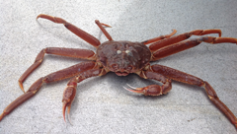
2025-05 Tanner Crab Report
William Stockhausen
AFSC/NMFS/NOAA
May 12, 2025

Slide 2
Outline
New Data and Analysis
GMACS Tanner model development
TCSAM02 alternative models
Recommendations

Slide 3
Work
SSC/CPT Requests Addressed
Develop GMACS model that matches current assessment model
substantial progress (but not completely finished)
Use BSFRF SBS selectivity analysis to provide priors on NMFS selectivity
partial: model 25_02 uses estimated capture probability curves
Show OSA residuals and diagnostics for size compositions
Develop likelihood profiles for model(s)
Compare “successful” and “unsuccessful” cohorts
Other
Compare AKFIN and crabpack data pulls (SAP request)
GMACS code
fixed issues with time blocks for survey catchability
added “zero pop” start option to match TCSAM02
added ascending normal selectivity curve option

Slide 4
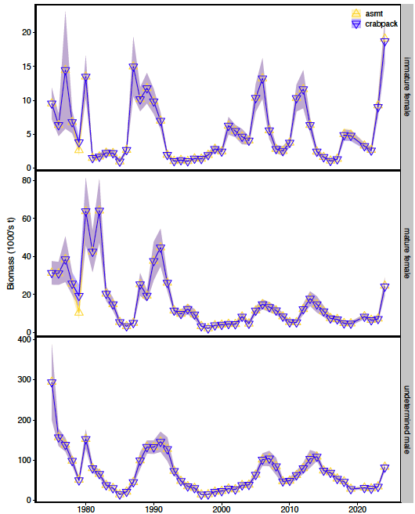
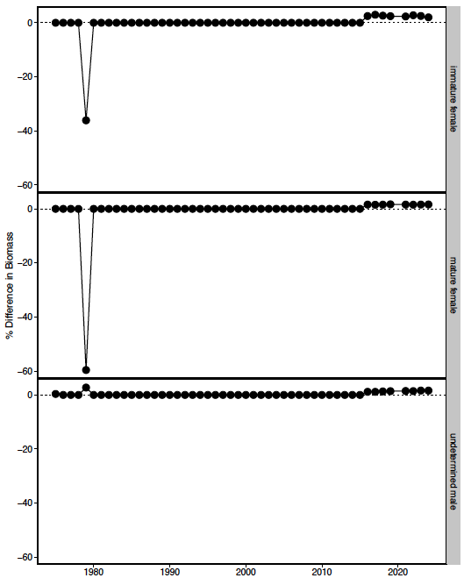
crabpack comparisons
1979: use standard stations
2016+: use best precision to convert CW to weight

Slide 5
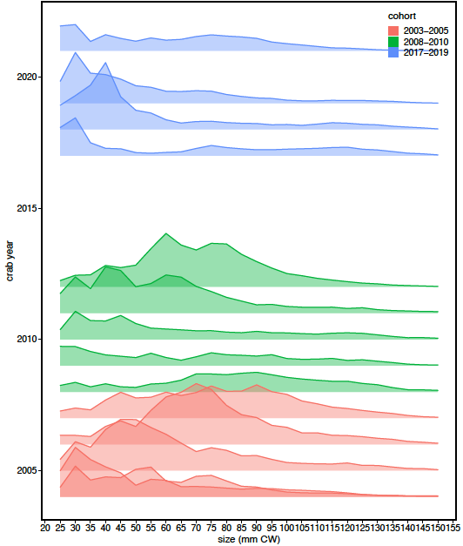
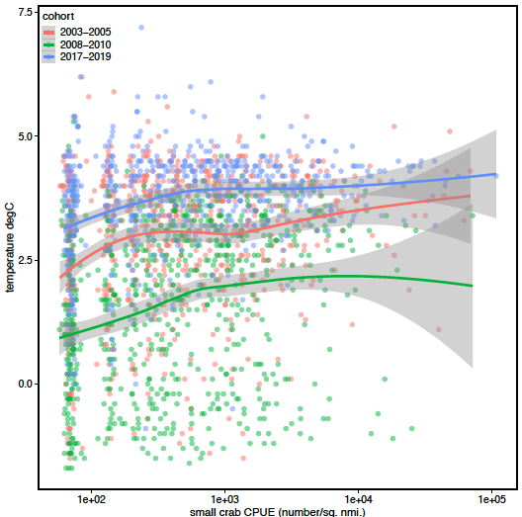
“successful” cohorts

Slide 6
Progress toward a GMACS model for Tanner crab
Lots of progress
what??
Still a ways to go
what??
Notes:
2022

Slide 7
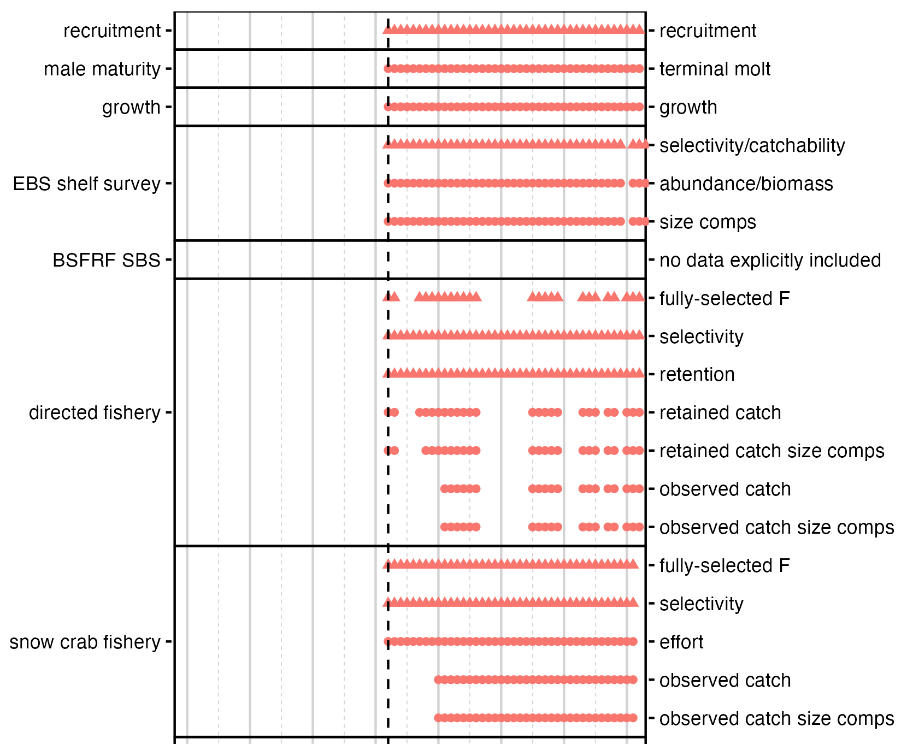
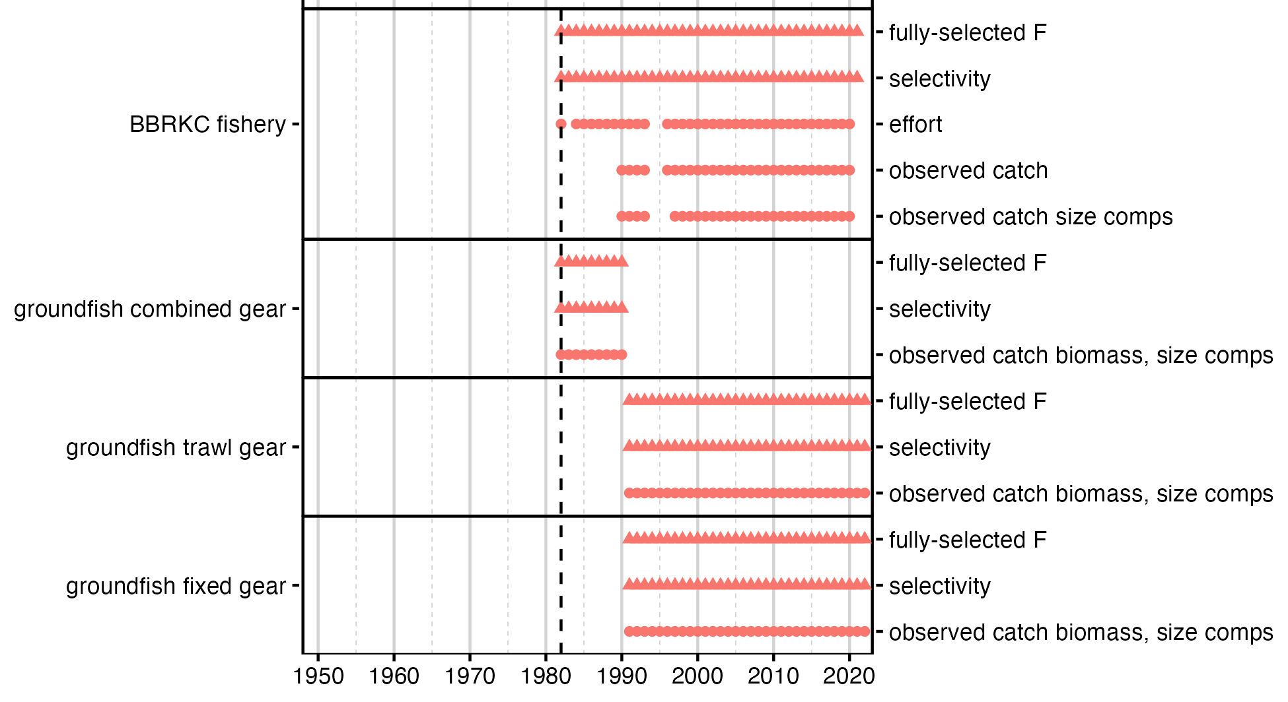
May2024: simplified GMACS model
Notes:
2022

Slide 8
Assessment model (22.03b) time frames and data
Notes:
2022

Slide 9
Assessment time frames: model processes
Notes:
updated 2024

Slide 10
Population dynamics
Notes:
2025

Slide 11
Fisheries
Notes:
2025

Slide 12
Fisheries
Notes:
2025

Slide 13
Surveys
Notes:
2025

Slide 14
Likelihoods
Penalties??
Notes:
2022

Slide 15
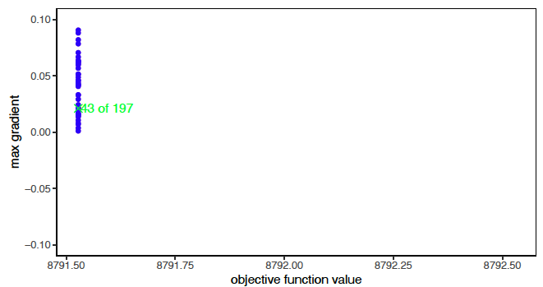
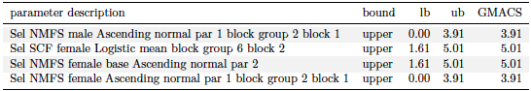
GMACS Models
Notes:
2022

Slide 16
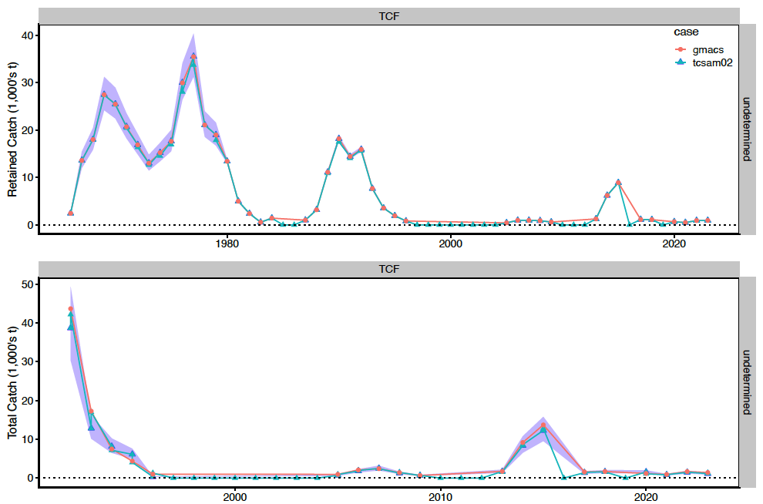
GMACS Models
Notes:
Fits to retained (upper) and total (lower) catch in the directed fishery.

Slide 17
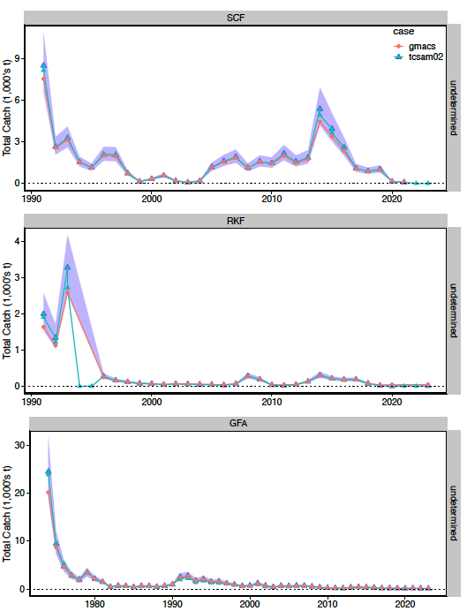
GMACS Models
Notes:
2022

Slide 18
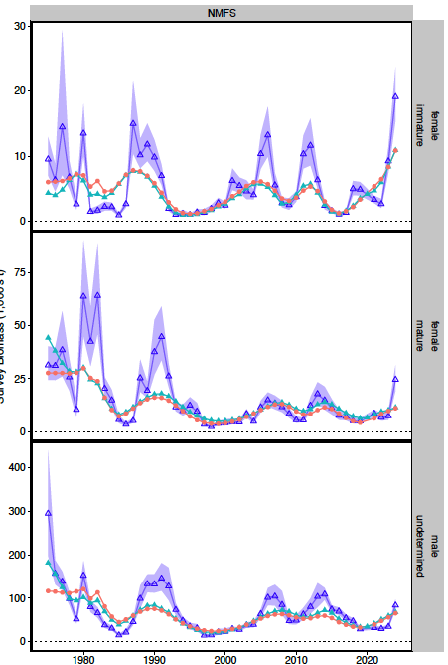
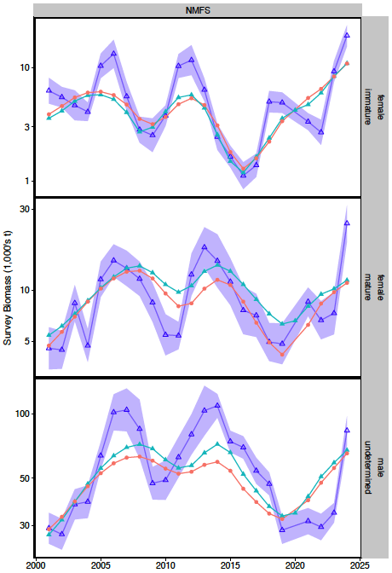
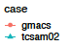
GMACS Models
Notes:
2022

Slide 19
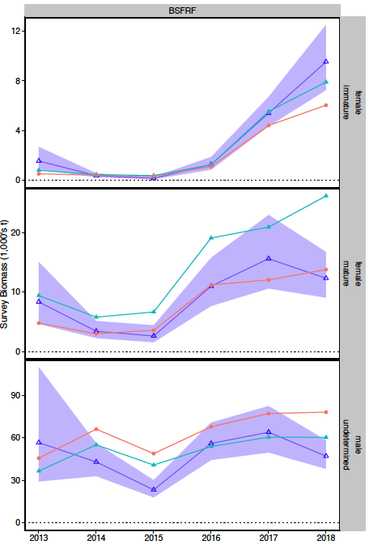
GMACS Models
Notes:
2022

Slide 20
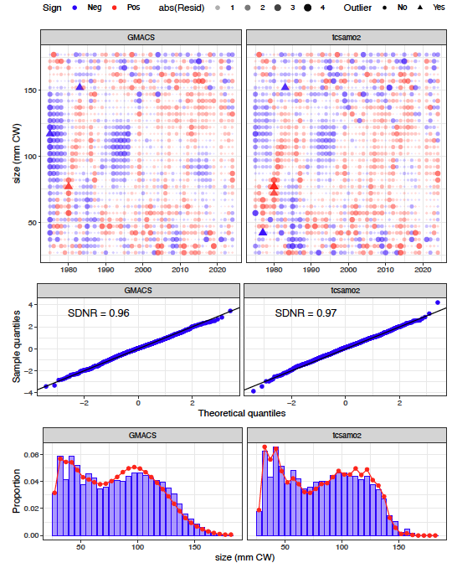
GMACS Models
Males
Notes:
NMFS survey

Slide 21
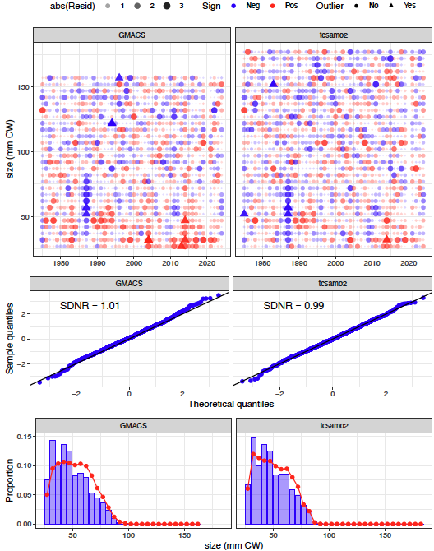
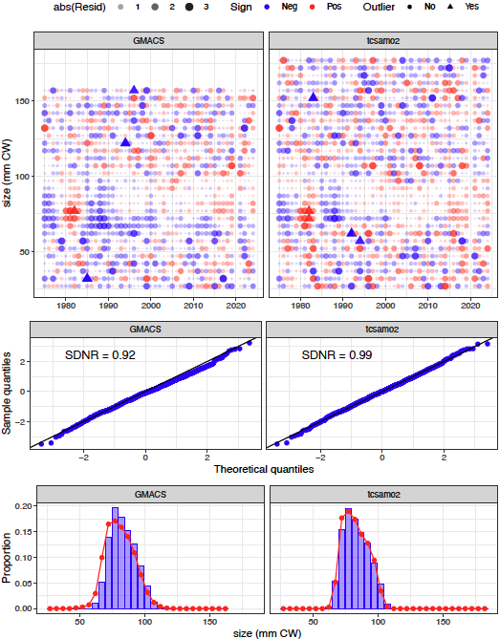
GMACS Models
Immature Females
Mature Females
Notes:
NMFS survey

Slide 22
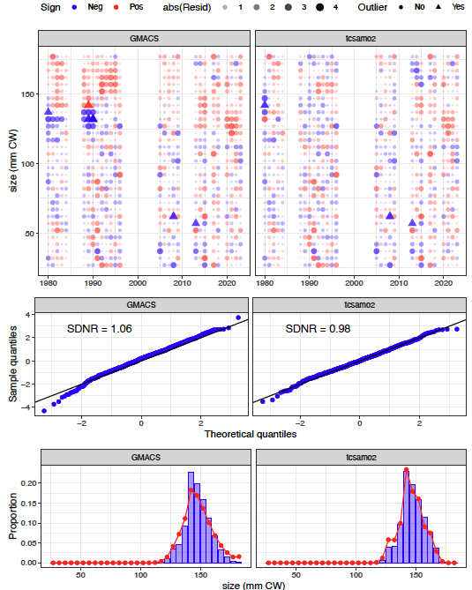
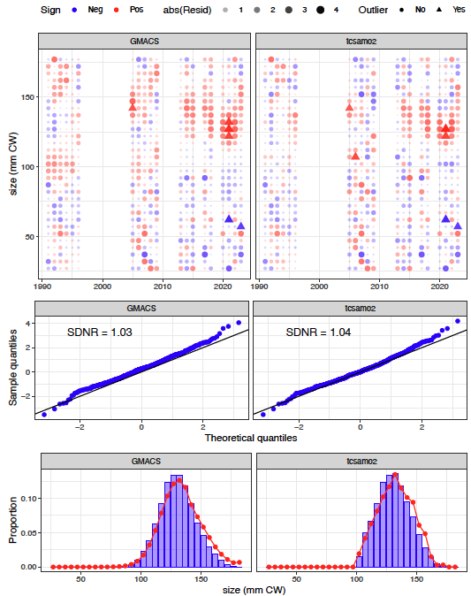
GMACS Models
Notes:
Directed fishery: retained catch (left columns); total catch (right columns)

Slide 23
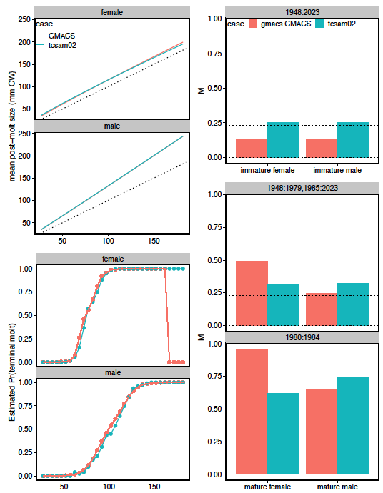
GMACS Models
Notes:
2022

Slide 24
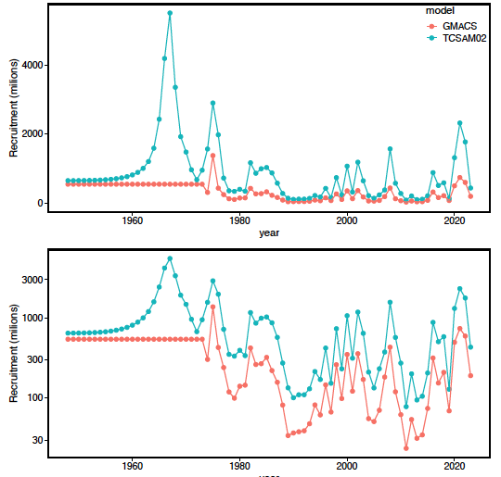
GMACS Models
Notes:
2022

Slide 25
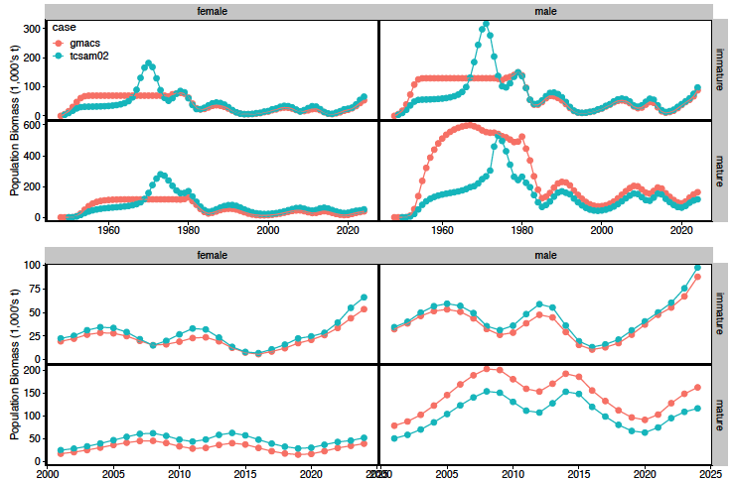
GMACS Models
Notes:
2022

Slide 26
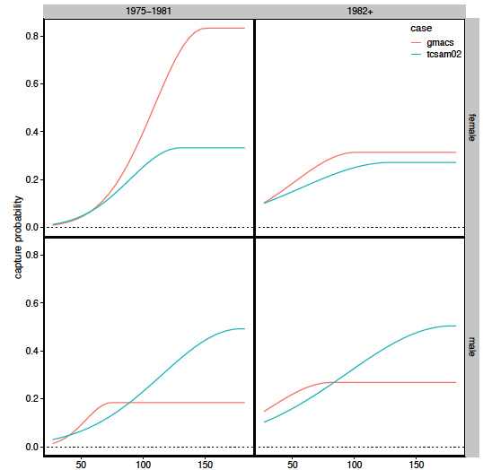
GMACS Models
Notes:
2022

Slide 27
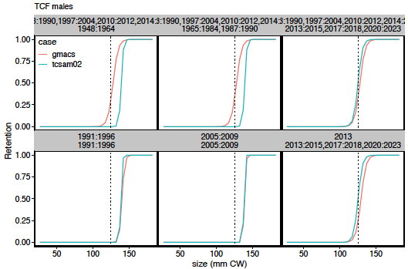
GMACS Models
Notes:
2022

Slide 28
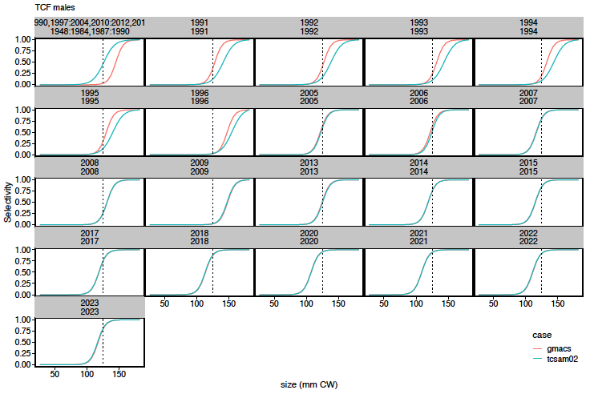
GMACS Models
Notes:
Total catch selectivity curves for directed fishery

Slide 29
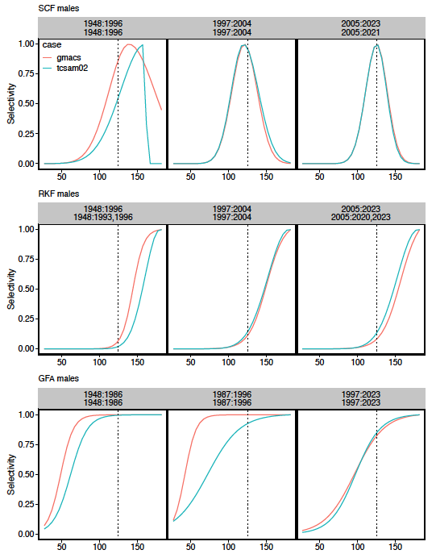
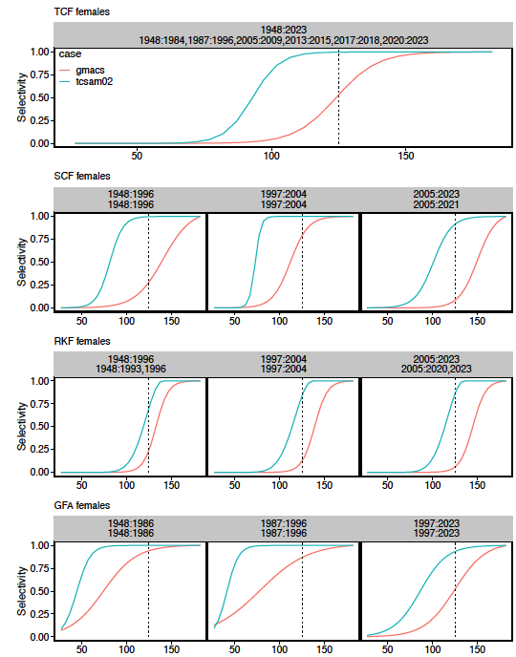
GMACS Models
Notes:
2022

Slide 30
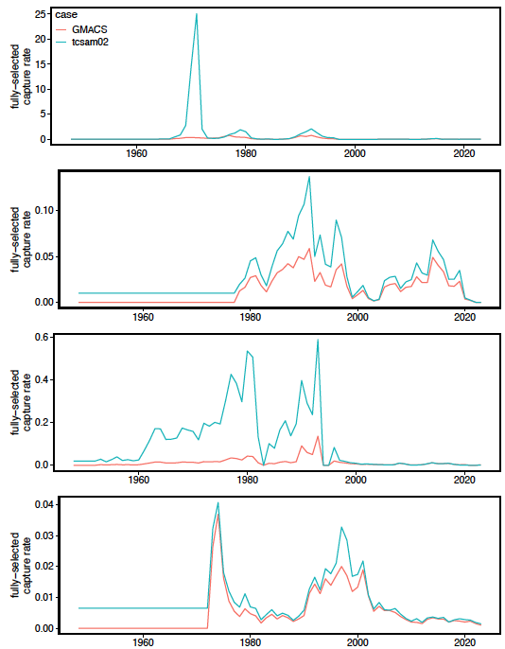
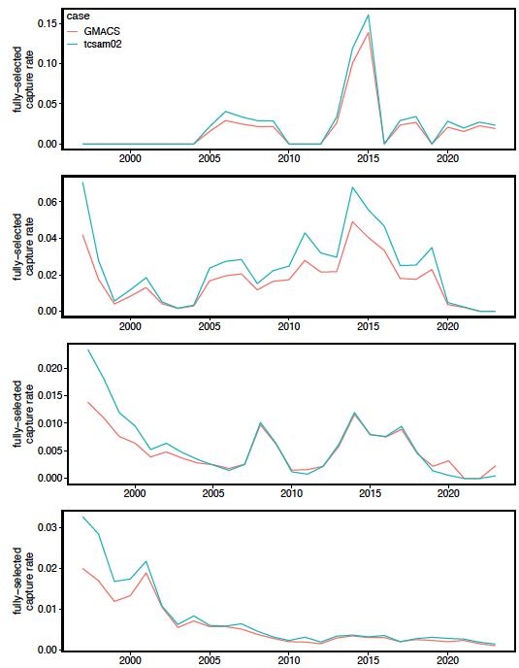
GMACS Models
directed
fishery
snow
crab
BBRKC
Groundfish
Notes:
2022

Slide 31
GMACS Models
Notes:
2022

Slide 32
TCSAM02 Models
Notes:
2022

Slide 33
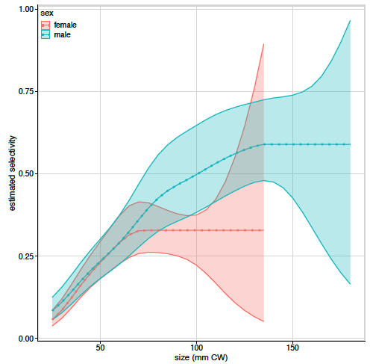
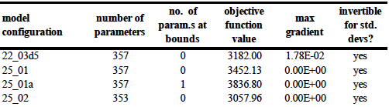
TCSAM02 Models
Used SBS-derived catchability curves for NMFS survey
No tail compression
survey observations
normally-distributed
22.03d5
25_01
25_01a
25_02
357
357
357
353
Notes:
Candidate alternative models

Slide 34
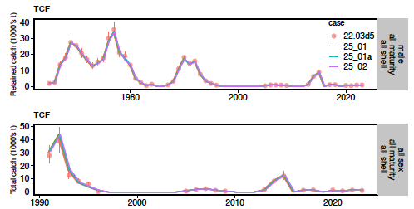
TCSAM02 Models
Notes:
Fits to directed fishery retained and total catch biomass

Slide 35
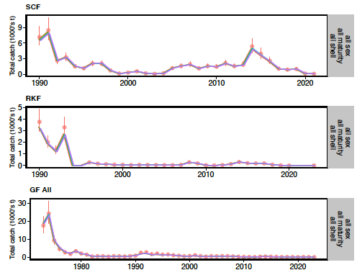
TCSAM02 Models
Notes:
2022

Slide 36
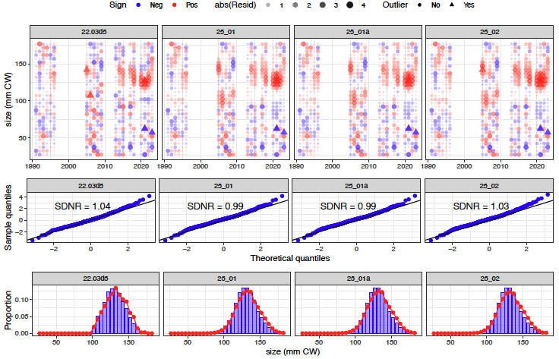
TCSAM02 Models
Notes:
total catch in directed fishery, males

Slide 37
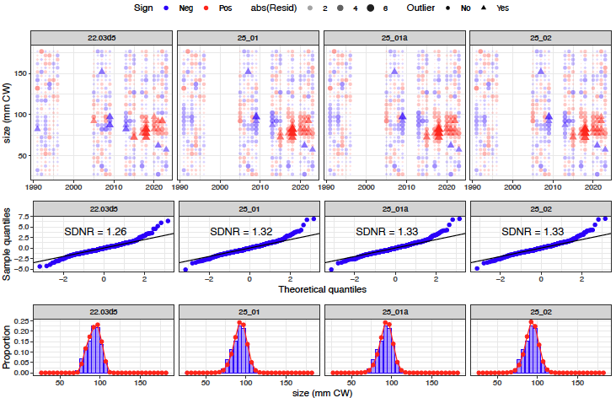
TCSAM02 Models
Notes:
females, directed fisehry total catch

Slide 38
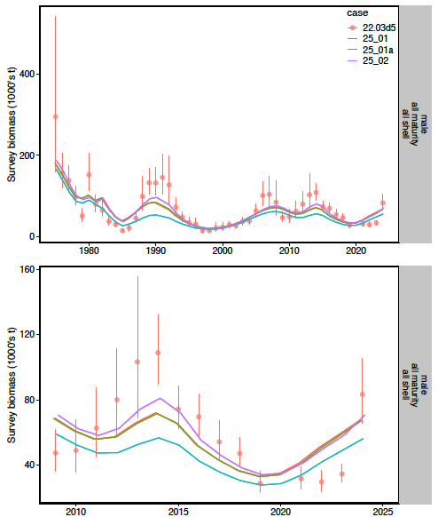
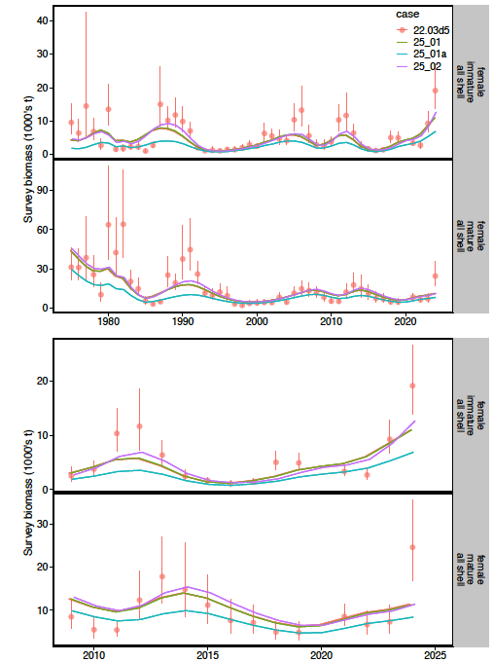
TCSAM02 Models
males
females
Notes:
Fits to survey data

Slide 39
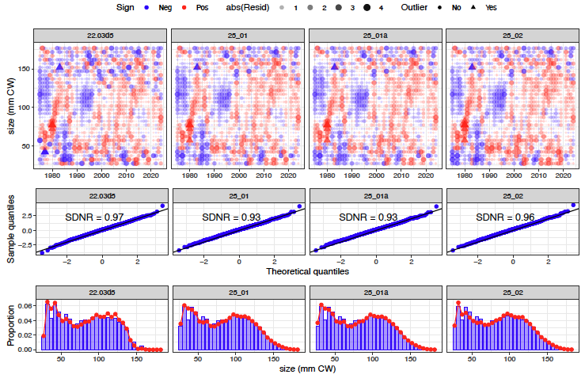
TCSAM02 Models
Notes:
2022

Slide 40
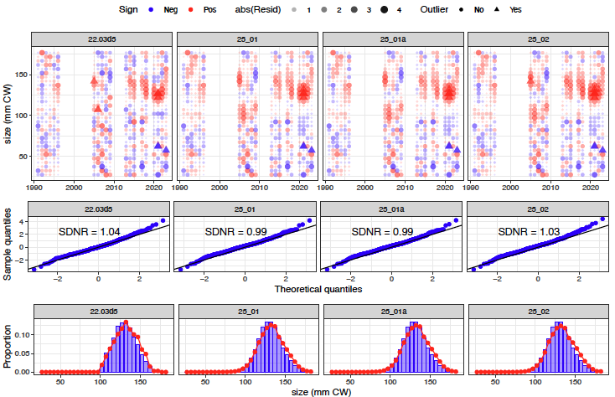
TCSAM02 Models
Notes:
2022

Slide 41
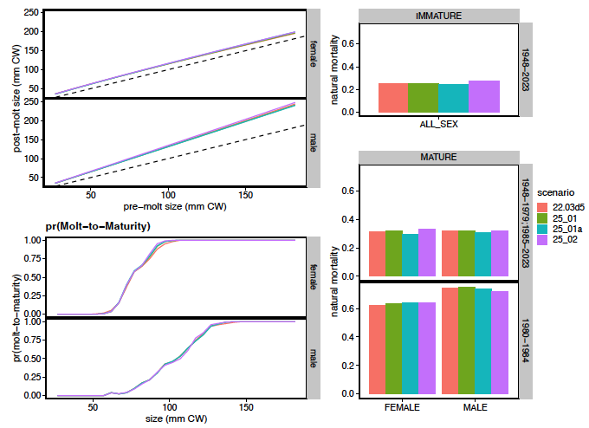
TCSAM02 Models
Notes:
2022

Slide 42
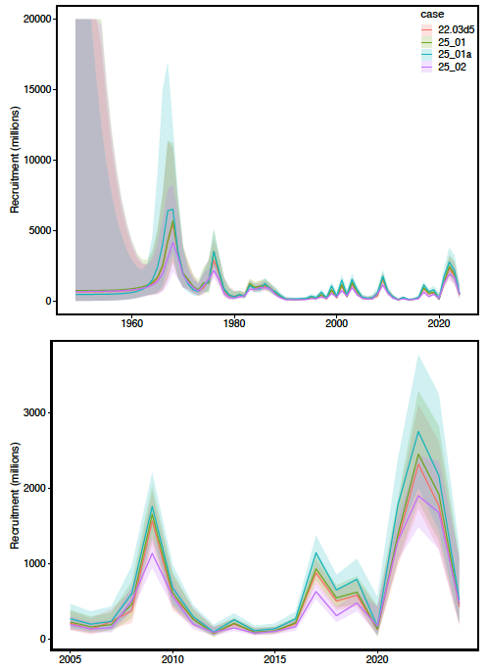
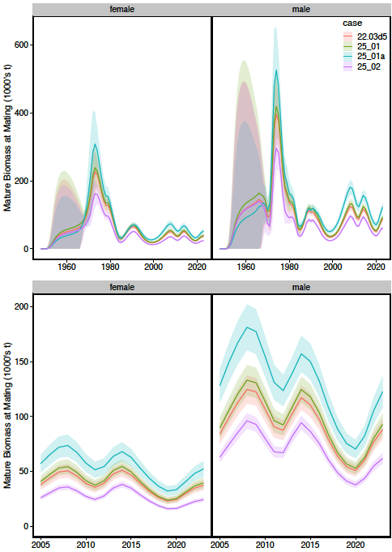
TCSAM02 Models
Recruitment
Mature Biomass
Notes:
2022

Slide 43
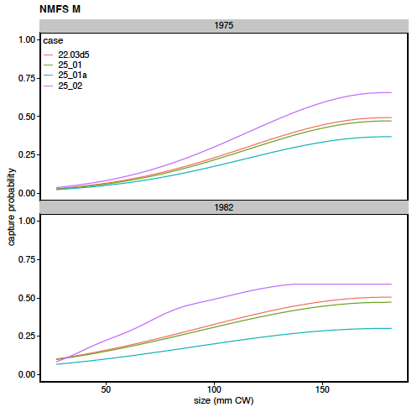
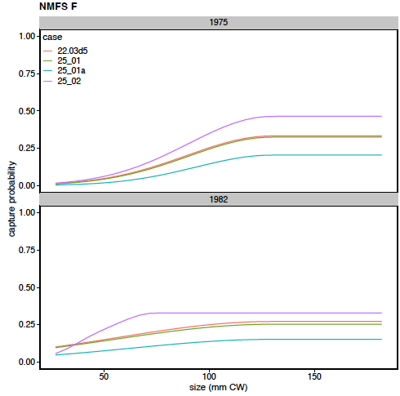
TCSAM02 Models
Notes:
2022

Slide 44
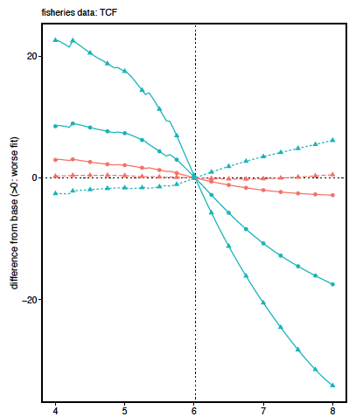
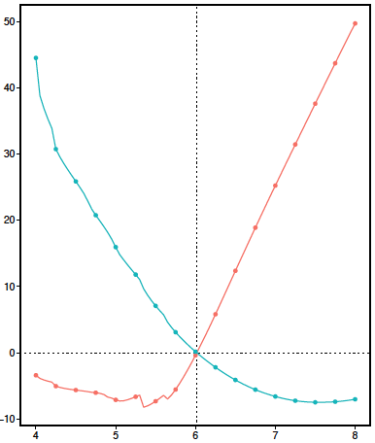
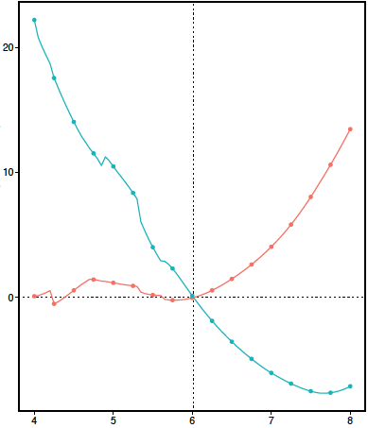
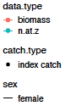
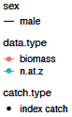


2024 Assessment Model: Likelihood Profiles
Directed Fishery
NMFS Survey Females
NMFS Survey Males
Total Likelihood
ln-scale recruitment parameter
Notes:
Likelihood profile results for objective function components in 2024 assessment model

Slide 45








2024 Assessment Model: : Likelihood Profiles
recruitment parameters
growth parameters
natural mortality parameters
survey catchability parameters
ln-scale recruitment parameter
Notes:
Likelihood profile results for parameter changes in the 2024 assessment model.
pLnR[1]: historical recruitment period. pRa[1]: fixed value. pRb[1]: fixed value.
pGrA[1]: males. pGrA[2]: females. pGrB[1]: males. pGrB[2]: females. pGrBeta[1]: both sexes.
pDM1[1]: multiplier for immature crab. pDM1[2]: multiplier for mature males. pDM1[3]: multiplier for mature females.
pDM2[1]: 1980-1984 multiplierfor mature males. pDM2[2]: 1980-1984 multiplier for mature females.
pQ[1]: NMFS trawl survey: males, 1975-1981. pQ[2]: NMFS trawl survey: males, 1982+.
pQ[3]: NMFS trawl survey: females, 1975-1981. pQ[4]: NMFS trawl survey: females, 1982+.

Slide 46

2024 Assessment Model: LPs
ln-scale recruitment parameter
Notes:
Likelihood profile results for management quantitiy changes in the 2024 assessment model.
avgRec: average recruitment, B100: unfished biomass, curB: current biomass, Fmsy: directed fishing mortality that results in MSY,
Fofl: directed fishing mortality that results in the OFL, MSY: maximum sustainable yield, OFL: overfishing limit, prjB: projected biomass.

Slide 47
TCSAM02 Models
Notes:
2022

Slide 48
TCSAM02 Models
Notes:
2022

Slide 49
Proposed Tier 3 models for September
2024 assessment model (TCSAM02 22.03d5) is “base” model
update with 2024/25 fishery/survey data
G25_05
resolve scaling differences with TCSAM02 model
provide complete analysis
management quantities,
retrospective patterns, etc
Notes:
2022

